Slide 1
Iot based Forest Fire detection
Anandhu S
S4 MCA
TVE20MCA-2010
Guide: Prof. Priya S A

Slide 2
INTRODUCTION
Found in a survey that 80% losses caused due to fire would have been kept away from if the fire was identified promptly.
As a solution , we have assembled fire finder utilizing Node esp32 microcontroller, interfaced with a temperature and humidity sensor, a smoke sensor and signal.
Whenever the fire is detected, the buzzer associated with esp32 gives us an alert sign by measuring the temperature, humidity and smoke produced during fire.
When a fire happens, the framework naturally facilitates and alarms the client by sending an alert to the telegram bot and to a page open through web.
Bell or alert is killed at whatever point the temperature goes to ordinary temperature and smoke level decreases.

Slide 3
PROBLEM STATEMENT
Cameras and satellite Imagining are existing methods to monitor/detect forest fire .
But there some limitation these systems has high false alert rate as a result of climatic conditions.
The existing one’s are not fast enough to detect fire as soon as possible and prevent it from spreading to more areas.
This project mainly focuses on the detection and sending alert to the admin as quick as possible .
IoT empowered woodland fire location, the process of detection of forest fire initiates at any of the nodes planted on a tree inside the forest.
The forest has a network of nodes placed at suitable distances from each other, the nodes have a capability to communicate through devices and by using esp32 .

Slide 4
If any change above a threshold value is found in the atmospheric parameters near a node , the information is passed to a nearest intermediate node until it reaches to the main/head terminal.
The main/head terminal uses a internet to pass the information to a forest fire monitoring website.
The website sends the alert to the telegram bot, along with the live location and sensor readings
The admin can view the sensor readings of any nodes at any time.
Use of maps reduces the difficulty to reach to the device location.

Slide 5
Literature review
Maheshwari, Latha & Janet, J & Jeevanandham, S & Kausic, S & Manish, M. (2021). Forest Fire Alerting System with GPS Co-ordinates Using IoT. Journal of Physics: Conference Series. 1916. 012099. 10.1088/1742-6596/1916/1/012099.
https://iopscience.iop.org/article/10.1088/1742-6596/1916/1/012099/pdf
The objective is to detect the fire in the forest and also to alert the forest officer.
The sensors including temperature sensor, smoke sensor and humidity sensor, with detecting the exact location of the fire and alert the nearby forest officer, with the help of GSM module and Bluetooth module.
When a fire catches, the sensors will detect unusual occurring, the code in the Arduino will be executed and alert the respective personnel.

Slide 6
Literature review
Miriyala, Trinath & Karthik, Ragipati & Mahitha, J & Reddy, V. (2018). IoT based forest fire detection system. International Journal of Engineering & Technology. 7. 124. 10.14419/ijet.v7i2.7.10277.
https://www.sciencepubco.com/index.php/ijet/article/view/10277
assembled fire finder utilizing Node Microcontroller which is interfaced with a temperature sensor, a smoke sensor and signal.
The temperature sensor detects the warmth
Smoke sensor detects any smoke produced because of consuming or fire.
Buzzer associated with Arduino gives an alert sign.
Whatever point fire activated, it consumes protests adjacent and produces smoke. Likewise, at whatever point warm force is high then additionally the alert goes on.
Bell or alert is killed at whatever point the temperature goes to ordinary room temperature and smoke level decreases.

Slide 7
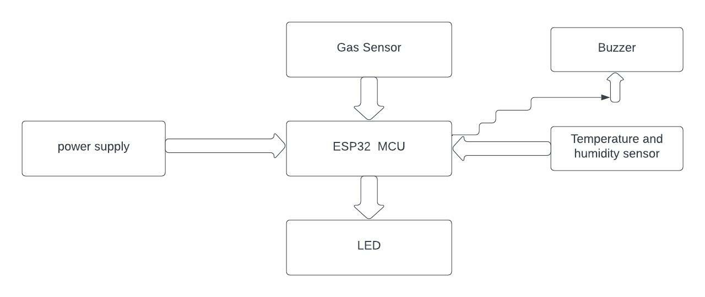
Block diagram

Slide 8
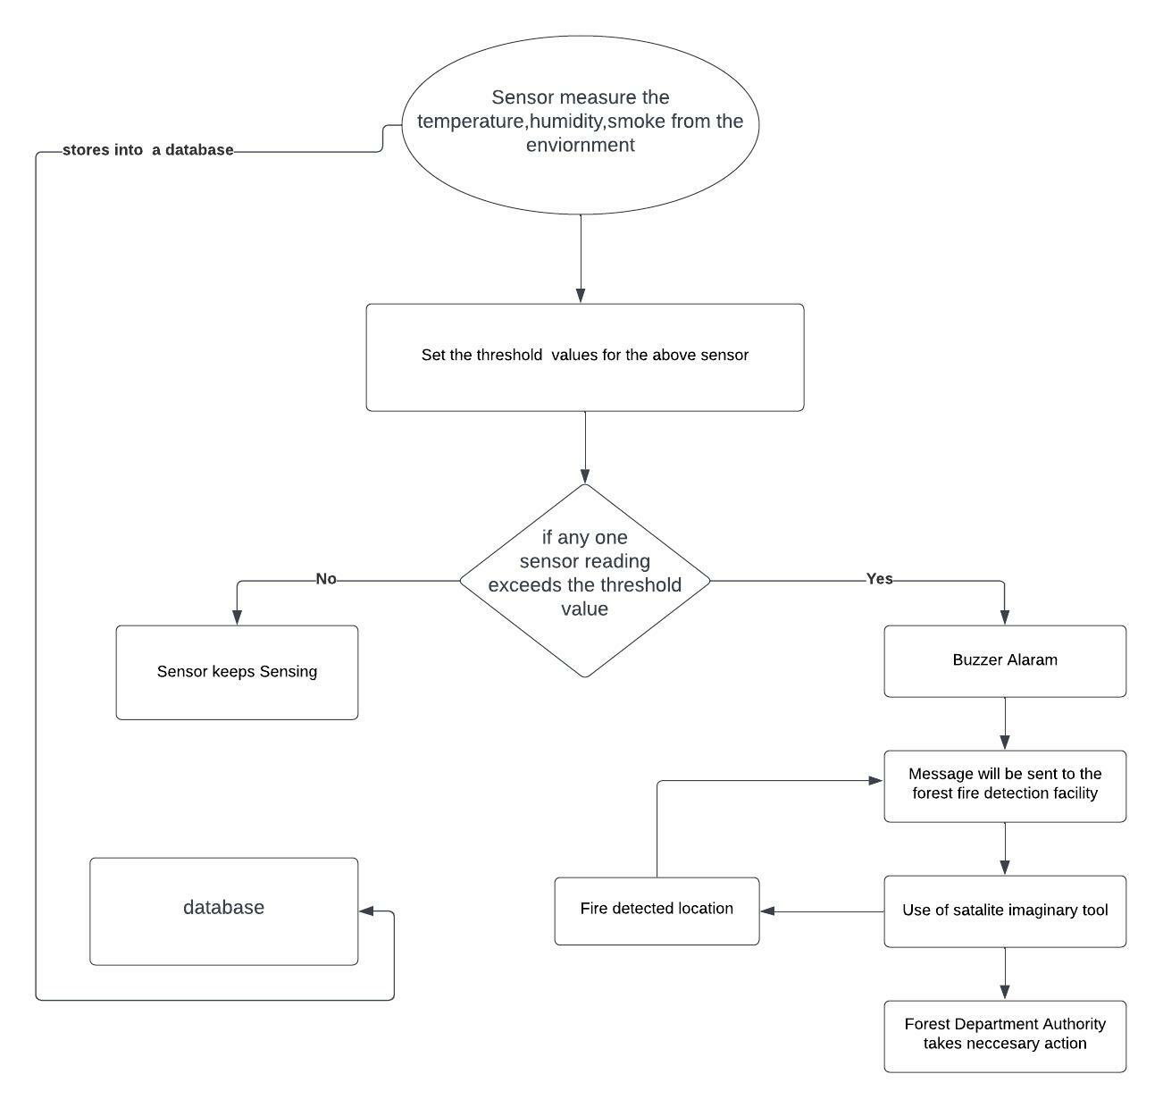
Flow chart

Slide 9
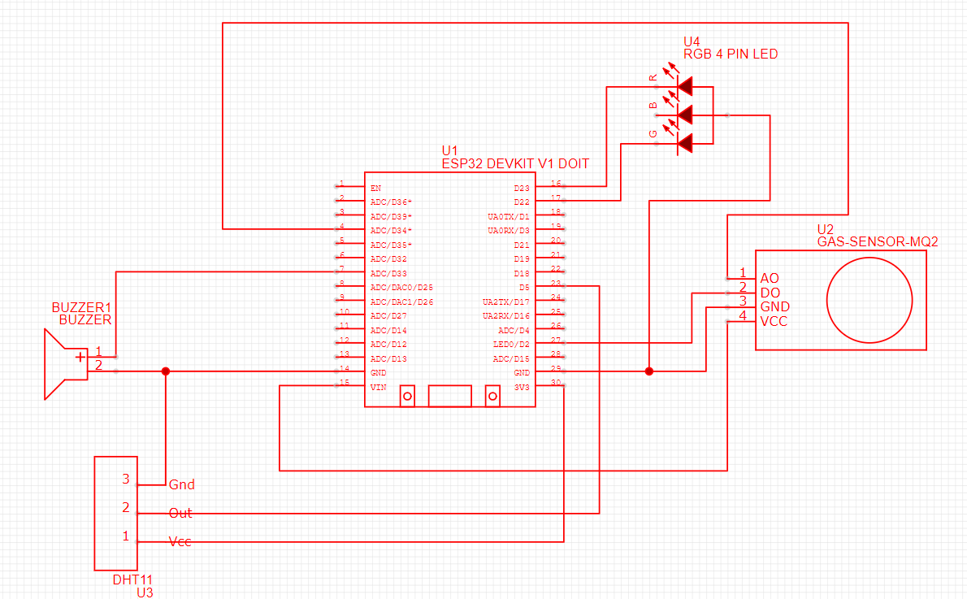
CIRCUIT diagram

Slide 10
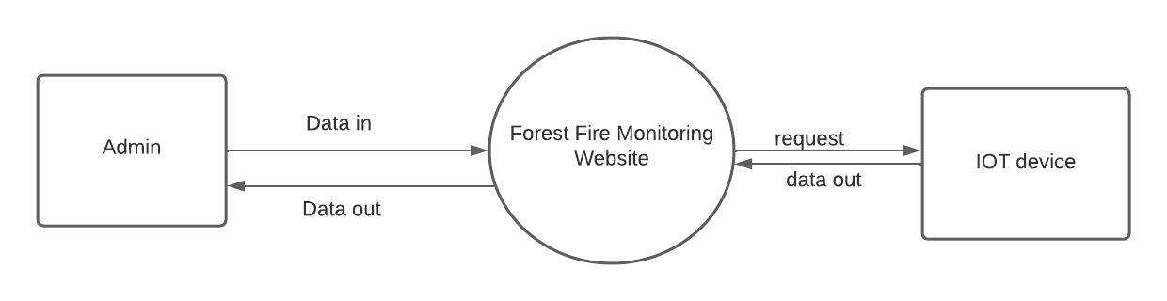
DATA FLOW DIAGRAM
Level zero

Slide 11
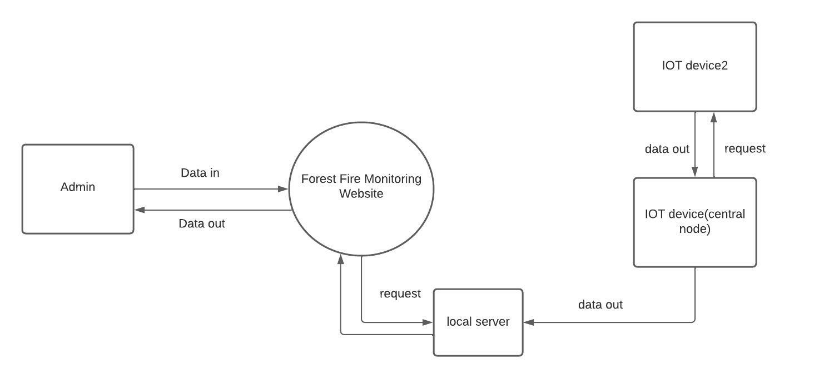
dfd level one

Slide 12
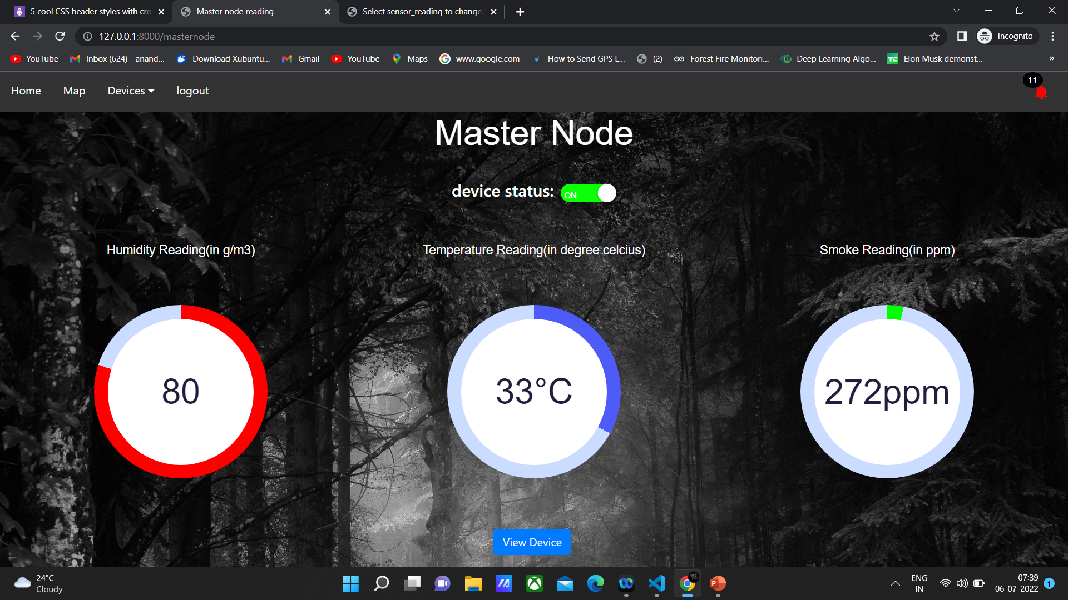
Screenshots

Slide 13
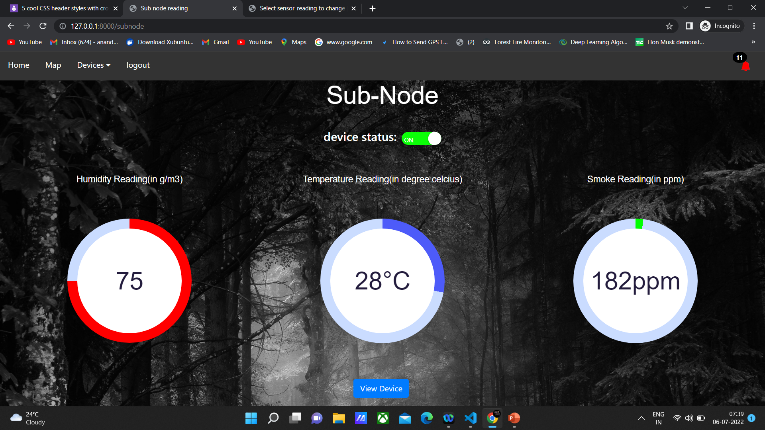

Slide 14
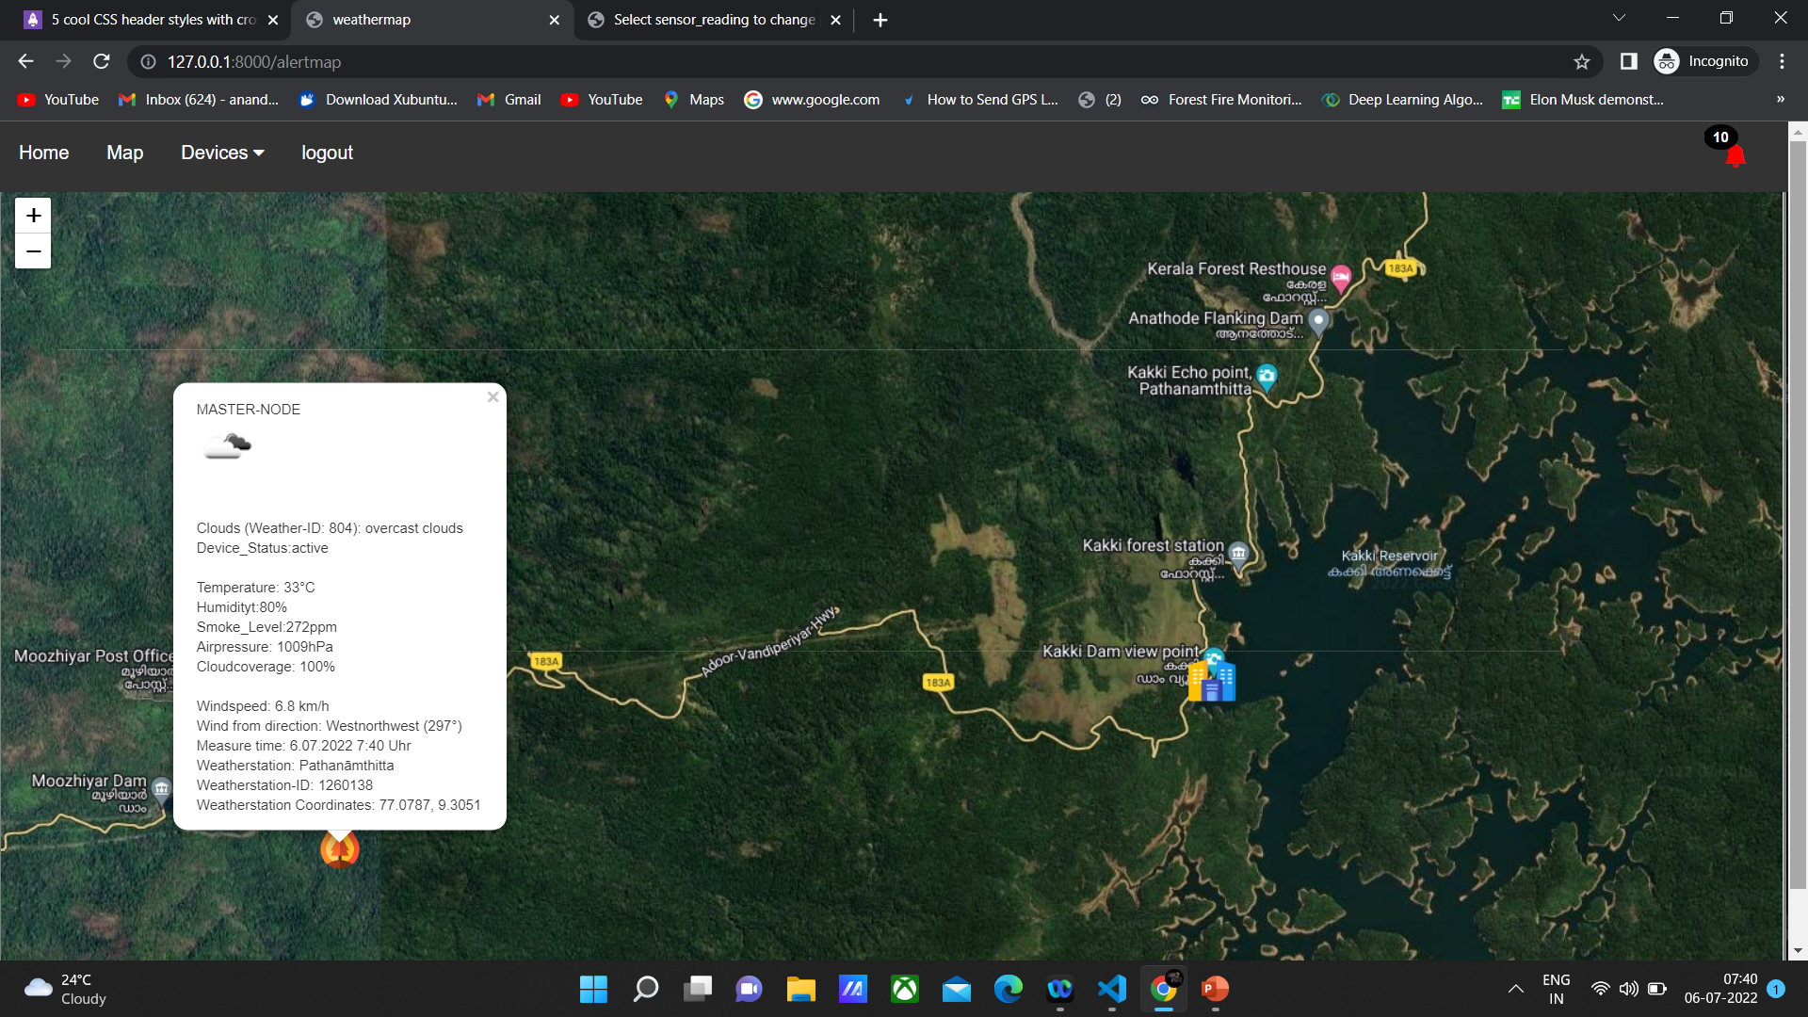

Slide 15

Database

Slide 16
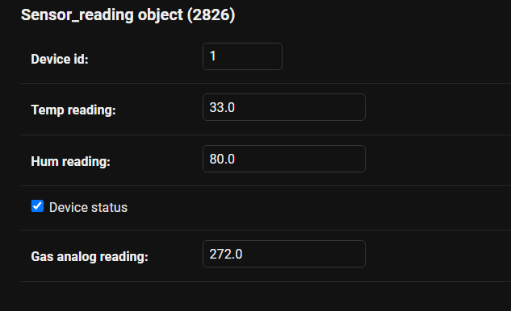

Slide 17
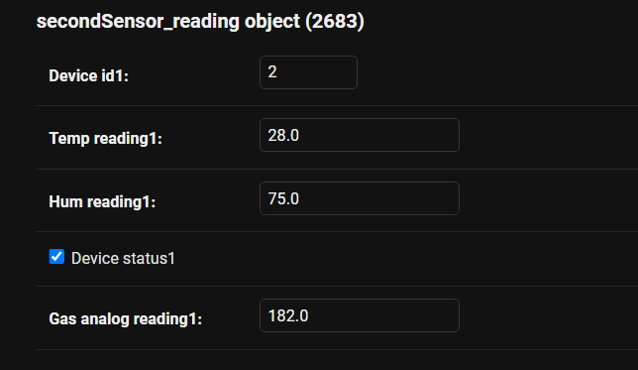

Slide 18
Technology USED
1. Arduino IDE
Special software allow you to write sketches for different Arduino boards.
The Arduino programming language is based on a very simple hardware programming language called processing, which is similar to the C language.
Inexpensive.
Open source in hardware.
Don't need to external programmer (Burner)
Open source in software.
IDE Software operate on any operating system.

Slide 19
2. Django
Django is a web application framework written in Python programming language.
It is based on MVT (Model View Template) design pattern.
The Django is very demanding due to its rapid development feature.
It takes less time to build application after collecting client requirement.
This framework uses a famous tag line: The web framework for perfectionists with deadlines.
By using Django, we can build web applications in very less time. Django is designed in such a manner that it handles much of configure things automatically, so we can focus on application development only.

Slide 20
3. HTML & CSS
HTML (the Hypertext Markup Language) and CSS (Cascading Style Sheets) are two of the core technologies for building Web pages.
HTML provides the structure of the page, CSS the (visual and aural) layout, for a variety of devices.
HTML is easy to Learn and Use
Supported by all browsers
Can easily Integrate with other languages
CSS provides consistent designs
Provide more website Speed

Slide 21
Future Works
Instead of WIFI/Hotspot the device communication can improved By using Lora(Long Range Radio)
which can provide more device range.
Upgrading device with GSM module(Global System for Mobile communication) and updating live location.
Replacing leafetjs with google maps ,provides More accurate routes.
Artificial intelligence the data from the sensors can be fed as input to further analyses it to find the frequencies.
other useful factors that determine a forest fire happening and obtain patterns from it and avoid further future forest fire.

Slide 22
Conclusion
Realizing the importance of existence of forests as it helps regenerate nature in the midst of all the destructive happenings in this world.
The importance of forests cannot be underestimated.
We depend on forests for our survival, from the air we breathe to the wood we use. Besides providing habitats for animals and livelihoods for humans, watershed protection, prevent soil erosion and mitigate climate change.
This model of forest fire detection will be very helpful in case of emergencies to alert officers.
future forest fires and make the world a better place to live for humans by conserving forests.

Slide 23
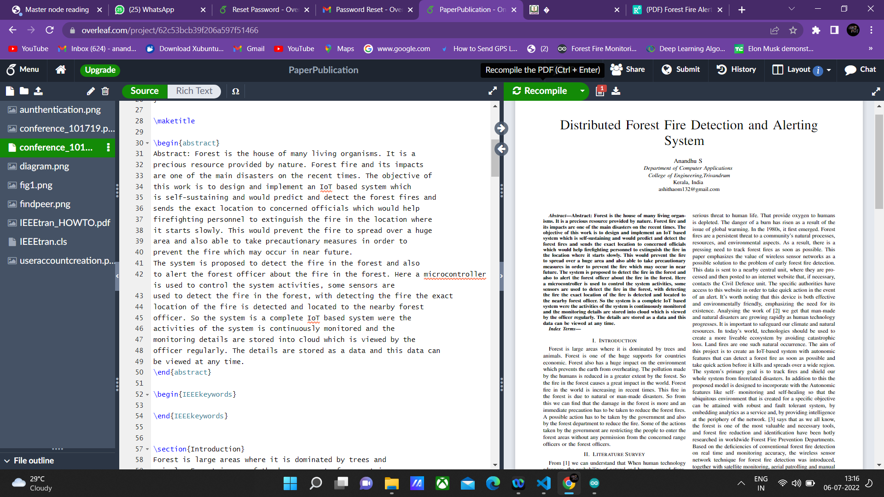
publication

Slide 24
References
Trinath Basu Miriyala, Ragipathi Karthik, J Mahitha , V Lokesh Reddy, “ IoT based fire detection system”. March 2018 International Journal of Engineering & Technology.doi:10.14419/ijet.v7i2.7.10277
2. Latha Maheshwari, J Janet , S Jeevanadham , S Kausic, “Forest Fire Alerting System with GPS Co-ordinating Using IoT”.May 2021 Journal of Physics Conference Series doi:10.1088/1742-6596/1916/012099

